Slide 1
Understanding your business goals
Open Box Approach

Slide 2
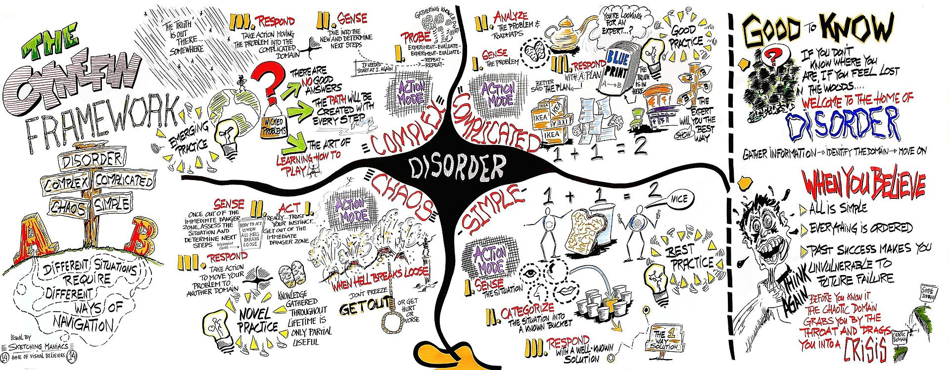
Why Agile?
Notes:
CYNEFN framework by Dave Snowden

Slide 3
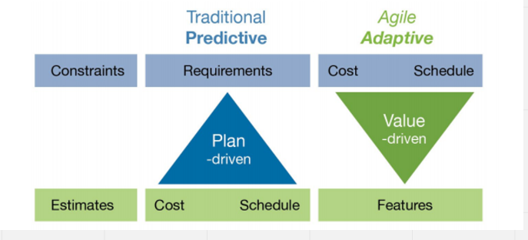
Value Driven Delivery

Slide 4
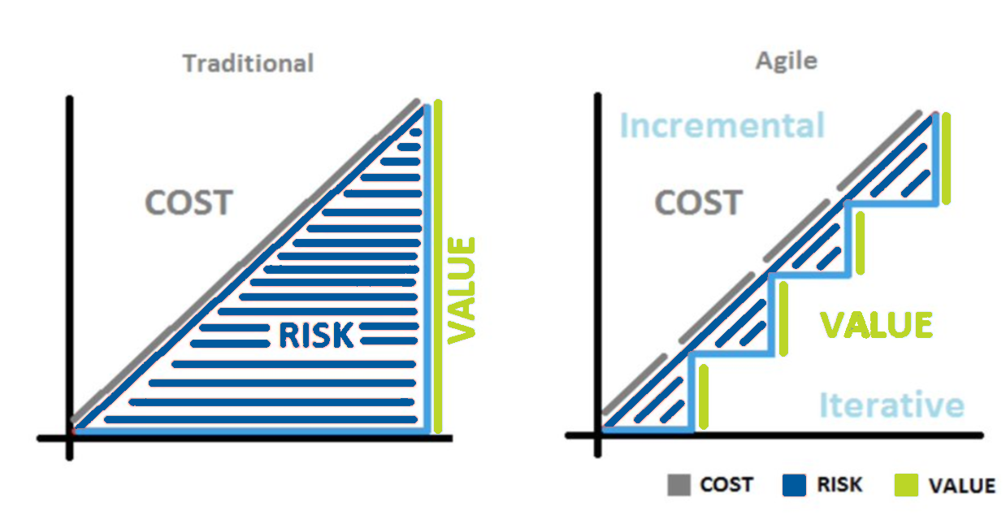
Why Agile?

Slide 5
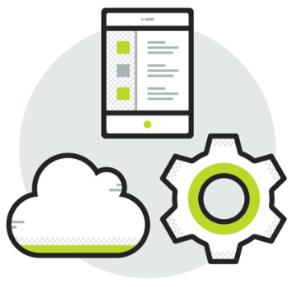
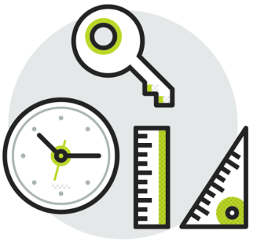

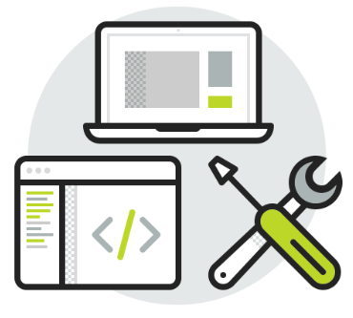
Why Agile?
Better Positioned to act to change
Maximize value delivery incrementally
Greater collaboration and communication
Better end-result, achieving business objectives

Slide 6
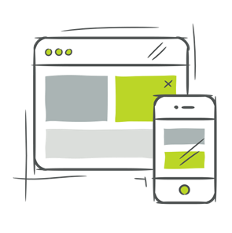

Agile Delivery
Open Box embraces the agile manifesto for flexible, results-driven delivery
Individuals and interactions
Customer Collaboration
Over processes and tools
Over Contract Negotiation
Processes and tools adjusted to each project and client’s needs.
Teams fully committed to the project and take personal ownership of deliverables
Teams reflect on their own performance and continuously make improvements
Processes are geared towards encouraging people having face to face communication.
Strong working relationship between client and delivery team
Regular interaction and collaboration
Changes to requirements should not require renegotiation of contracts
Working Software
Over comprehensive documentation
Responding to change
Early and continuous delivery of working software is highest priority
Documentation produced through delivery as a living, real-time record of the project
Digital documentation at the user story level favoured over lengthy specs
Over following a plan
Projects must respond to changing business needs in the real world environment
Incremental delivery means regular review and re-assessment of scope and priorities
Changes to requirements are expected and are not show-stoppers.
Projects are optimised for adaptability as opposed to predictability
  Open Box’s willingness to work alongside us, even before a contract is signed means that the cost and timelines are always highly accurate
Head of Product Delivery, JLL
Notes:
Rule books tell people what to do. Frameworks guide people how to act. Rule books insist on discipline. Frameworks allow for creativity. Simon Sinek. Open Box always try to find a way to say yes
What this means is:
Working software
Doc – we still produce the best documentation

Slide 7
“Sprint 0”
Inputs
Outputs
Initial contract signed to authorise a consultant's time for "Sprint 0“
A sized initial backlog of the User stories that are anticipated to form part of the project.
A fixed period to engage with key stakeholders in order to further develop the user story map with the aim of identifying the epics and stories that will help quantify the likely duration and cost of the project.
An anticipated team makeup required to achieve the desired outcomes. This forms the basis of the initial cost and schedule forecast
Notes:
NB: Effort is comparable to each other and not time based

Slide 8
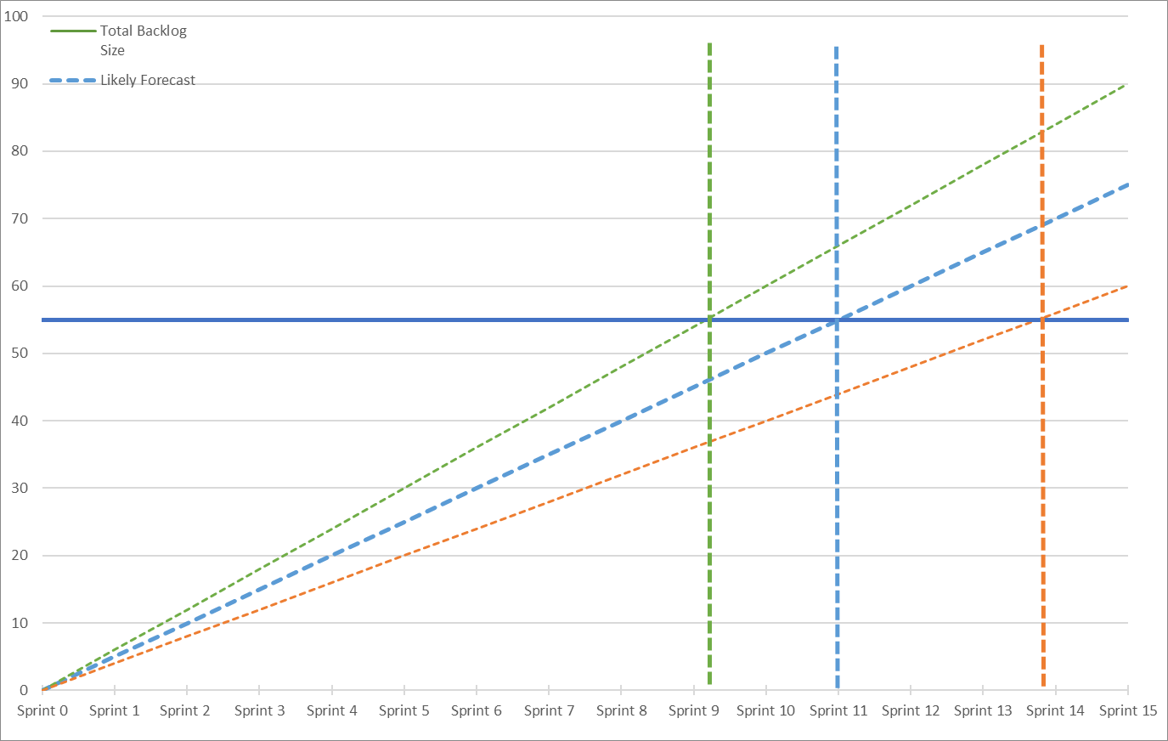
What it will take to achieve your objectives
Notes:
NB: Effort is comparable to each other and not time based

Slide 9
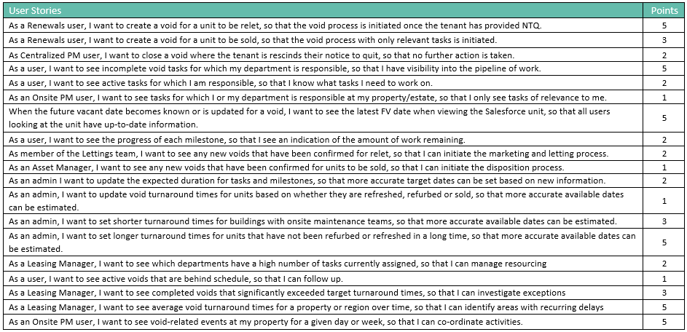
“Sprint 0”
Notes:
NB: Effort is comparable to each other and not time based

Slide 10
Maximizing Value
Value generated from Sprint 0
Clear view of outcomes to be achieved
Forecast of effort and resource allocation
Roadmap as to the way forward
Initial Backlog

Slide 11
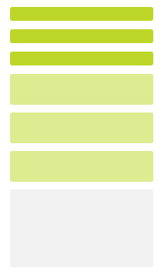


Sprint Cadence
Iterative delivery is achieved through a series of 3-week sprints
Process Improvement
Sprint Retrospective
Open Box Activity
Client Activity
Joint Activity
Daily Stand-up
3-week Sprint
Sprint Planning
Sprint Demo
Testing
Product Increment
Sprint Backlog
Product Backlog
Backlog Refinement & Prioritisation
Backlog Refinement
Feedback

